Slide 1
Welcome to
DVSE RO!
React Presentation
Târgu Mureș, RO
Bükkei Edwin

Slide 2
What is react?
JavaScript framework and library
Single-page application (SPA)
Virtual DOM
Examples:
Facebook
Instagram
Netflix
SoundCloud
Reddit
Notes:
React este un framework foarte folosit de catre developerii de front end
Ce face react? Iti poate face un build de SPA, ce este SPA? Single page application, deci se incarca numai un fisier de html, si face updateuri in pagina aia cu Javascript
Altfel se poate numi si client side routing, fiindca browserul nu descarca pentru fiecare pagina in index nou, ci doar updateaza acesta, ce il face mai dinamic
Virtual DOM este o copie dupa DOM, modificarile in website sunt instante in virtual DOM, dupa care react face diferenta intre DOM si VDOM, si updateaza doara ce sa modificat
Asa ca nu face atatea rerenderuri

Slide 3
SPA VS MPA
Single-page application Multi-page application
SPA
MPA
Pros:
Fast
Simplified development
Easy debug
It can also work offline (Caching)
Cons:
Bad SEO support
JavaScript needs to be enabled
Less secure
Pros:
SEO friendly
Scalability
Less packages
Easy analytics
Cons:
Each modification loads page
More development time
Hard to maintain

Slide 4
Creating a react app
Toolchains

Slide 5
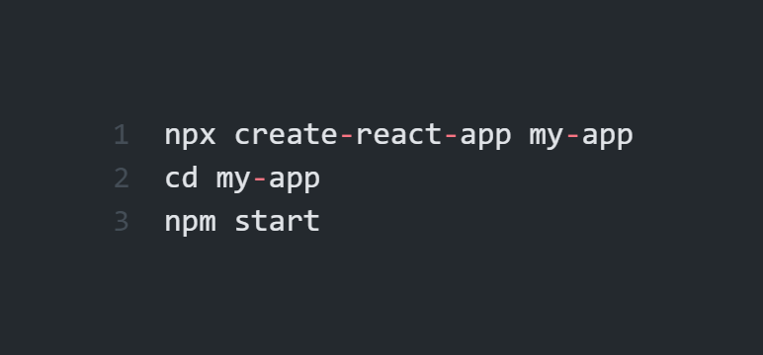
Create React App
Single-page application
Latest JavaScript features
Good for learning react

Slide 6
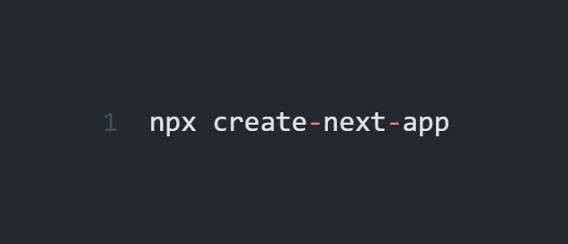
Create Next.JS App
Full-stack react framework
SEO Friendly
Server-side and client side rendering

Slide 7
Folder structure

Slide 8
Why is it important to understand?
What does it contain?
node_modules
All dependencies required by the app
public
Static assets, Index.html
“root” is out entire app
src
This is where we write our code
This code will be inserted in the public folder in the build process
.gitignore
Files that need to be ignored in Git
package.json
List of dependencies, every node.js project has a package.json
package-lock.json
Do not edit
Snapshot of the dependency tree

Slide 9
Components

Slide 10
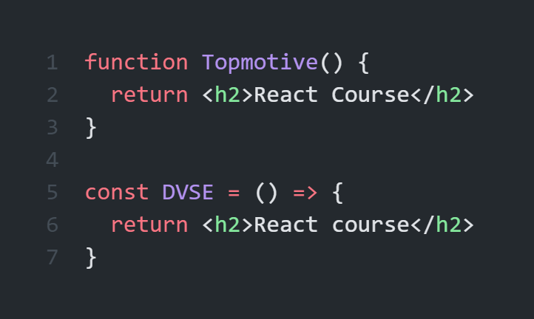
Components
Basics
Starts with capital letter
Returns HTML (JSX)
Can be of two types:
Function
Arrow function

Slide 11
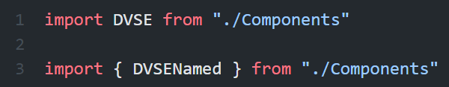
Components
Export
Components need to be exported to use them
There are two types of export:
Named export
Default export

Slide 12
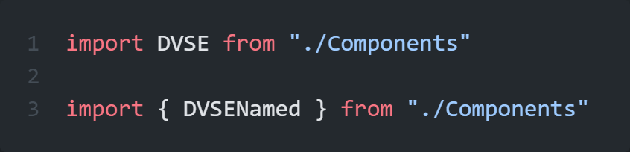
Components
Import
In order to use a component we need to import it
There are two types of import:
Named import
Default import

Slide 13
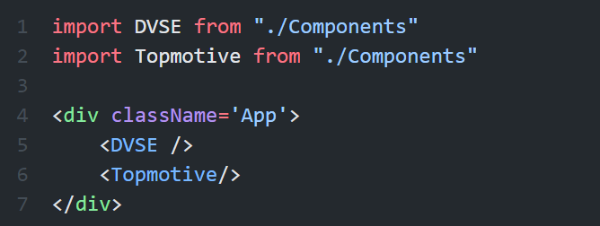
Components
Usage
Components can be used from other components
Helps code reusability (make reusable components)

Slide 14
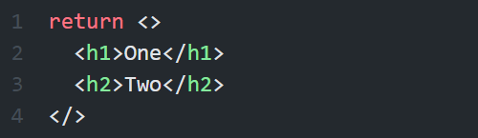
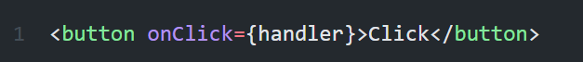
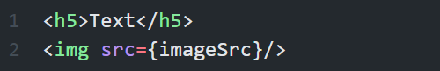
Components
Rules
Return single element
If need to return more elements use Fragment, div
camelCase naming
className instead of class
Every tag must be closed

